Slide 1


WEDDING MANAGEMENT SYSTEM
IT252
CHIKKERI CHINMAYA (211IT017)
RAJU V B (211IT051)
UMESH (211IT073)
VISHWA MOHAN REDDY (211IT082)

Slide 2
CONTENTS OF THE PROJECT
01
INTRODUCTION
02
PROBLEM STATEMENT
03
IMPLEMENTATION
04
DESIGN

Slide 3
CONTENTS OF THE PROJECT
05
DEMONSTRATION
06
CHALLENGES
07
FUTURE ENHANCEMENTS
08
CONCLUSION

Slide 4

INTRODUCTION
01
The “Wedding Management System" is a web-based application designed to simplify the process of registering marriages and issuing marriage certificates. This system allows couples to conveniently register their marriages online, eliminating the need for physical visits to government offices and reducing paperwork. Users can create accounts, fill out marriage registration forms, submit required documents, and have their information verified by government officials. Once approved, the system generates a unique registration number and issues a digital marriage certificate, saving time and providing an efficient way to complete the marriage registration process.

Slide 5




PROBLEM STATEMENT
02
Wedding planning can be a complex and time-consuming process. Some of the challenges include Like Coordinating with multiple vendors such as caterers, photographers, florists, and decorators require effective communication and organization.
Weddings often involve significant financial investments, and keeping track of expenses, payments, and invoices can be overwhelming.
With numerous tasks to be completed within specific timelines, staying organized and ensuring everything is on track can be challenging.

Slide 6
IMPLEMENTATION
03
The implementation of a Wedding Management System (WMS) using MySQL, PHP, JavaScript, and CSS involves utilizing each technology for specific purposes. SQL is used to create and manipulate the database tables, PHP handles the server-side logic and interaction with the database, JavaScript enhances user interactivity and provides dynamic content, and CSS handles the styling and layout of the web pages.
These technologies work together to create a comprehensive and functional WMS, allowing for efficient management of guest information, vendor details, tasks, budgets, and more.
The combination of SQL, PHP, JavaScript, and CSS ensures a seamless and user-friendly experience for both wedding organizers and participants.

Slide 7
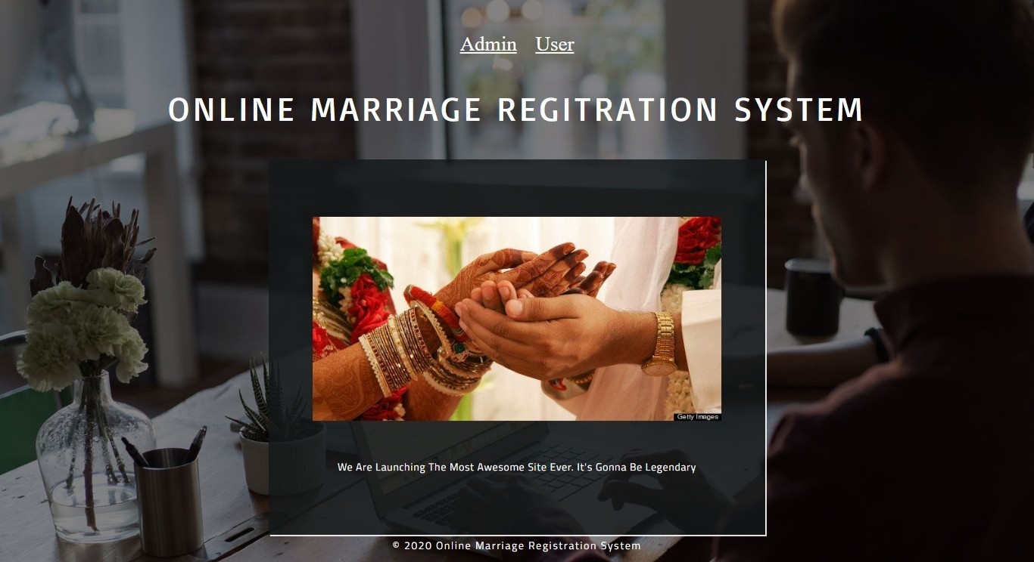
DESIGN
04
HOME PAGE

Slide 8
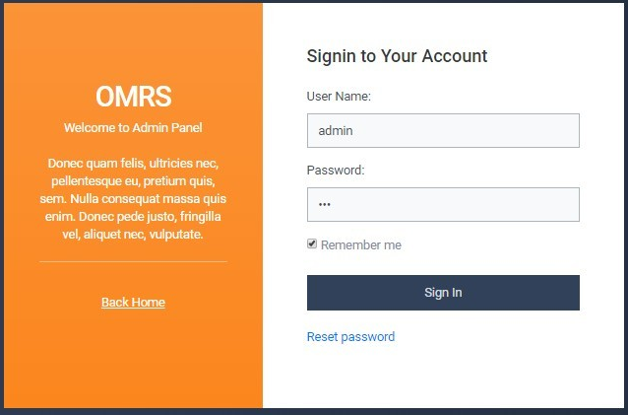
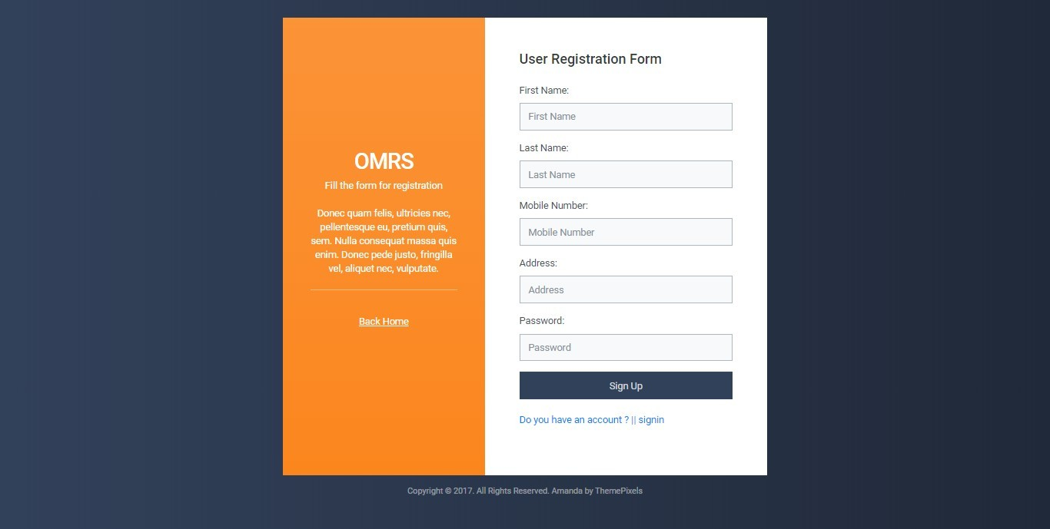
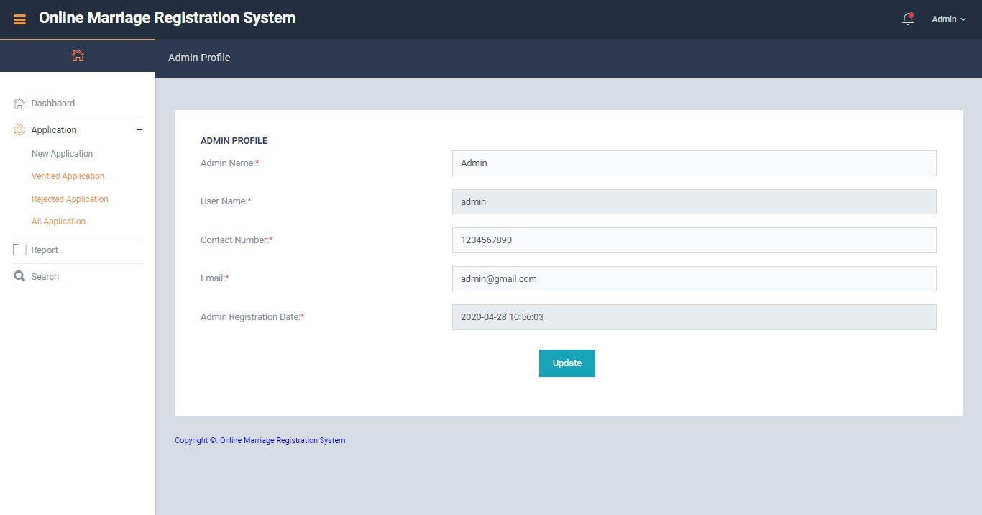

Slide 9
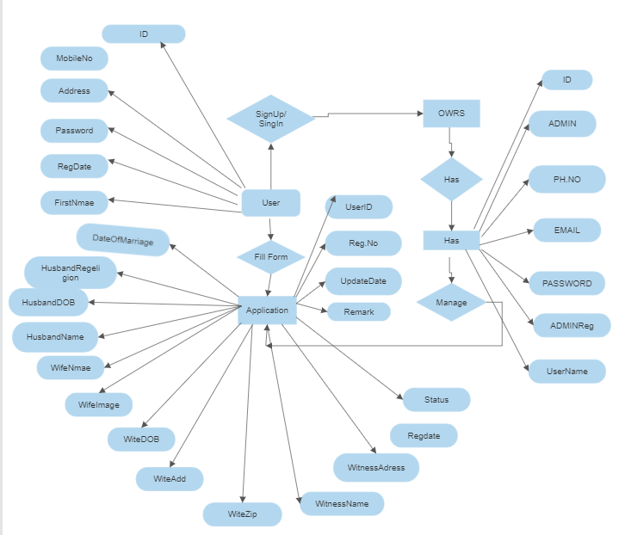
ER-DIAGRAM

Slide 10
DEMONSTRATION
05

Slide 11
CHALLENGES
Security is a critical aspect of any web application, including a WMS. Protecting sensitive data and preventing unauthorized access is essential.
Thorough testing and quality assurance are essential to identify and fix any issues or bugs in the system.
Designing the system with scalability in mind, such as using efficient database indexing, optimizing queries, and employing caching mechanisms, can help ensure the system can handle increasing loads.
Creating an intuitive and user-friendly interface for the WMS is vital for user satisfaction.

Slide 12
FUTURE ENHANCMENT
Integration of Payment Gateways: Incorporate popular payment gateways to allow users to make online transactions for various services such as venue booking, catering, photography, and more.
Calendar and Reminder Features: Develop a calendar feature within the system that allows users to manage important dates and milestones related to their wedding, such as booking dates, vendor meetings, dress fittings, and more.
Calendar and Reminder Features: Develop a calendar feature within the system that allows users to manage important dates and milestones related to their wedding, such as booking dates, vendor meetings, dress fittings, and more.
Social Media Integration: Integrate social media platforms to enable users to share updates, photos, and moments from their wedding planning journey directly through the system.

Slide 13
CONCLUSION
This Application provides a computerized version of Marriage Registration which will benefit the people who want to register their marriage. It makes the entire process online and can generate reports. It has a facility of admin login where admin can fill the marriage details and generate a certificate. The Application was designed in such a way that future changes can be done easily.

Slide 14




THANK YOU.!

